Slide 1

KNOWLEDGE INSTITUTE OF TECHNOLOGY COMPETITIVE ANALYSIS OF LEADING TRAVEL AGGREGATORS DATA ANALYTICS
MENTOR NAME: M.GOPIKUMARAN B.Tech.,M.E
ASSISTANT PROFESSORCOMPUTER
SCIENCE AND BUSINESS SYSTEM
TEAM :
GNANAVEL P (611220104304)
VENKATAPATHY R (611220104319)
SATHYASEELAN A (611220104313)
SUDHARSANAN V (611220104316)

Slide 2
OBJECTIVE
To analyses the “Leading Travel Aggregators” using IBM Cognos.

Slide 3
ABSTRACT
A travel aggregator is a website or platform that allows users to search and compare prices for travel-related products and services, such as flights, hotels, vacation rentals, and car rentals, from multiple providers. Travel aggregators typically provide a simple and convenient way for users to find and book travel products and services, and often offer additional features such as reviews, ratings, and photos to help users make informed decisions. Some popular examples of travel aggregator websites include Expedia, Booking.com, Kayak, and Trivago. Travel aggregators typically generate revenue by charging commissions or fees to the travel providers whose products and services are featured on their platform. Some also earn revenue through advertising, or by offering additional services such as travel insurance or car rental. An analysis of a travel aggregator can be a great opportunity to understand the travel industry trends, consumer preferences, and the impact of external factors on the travel industry. This can be done by analyzing the data from the travel aggregator such as bookings, reviews, prices and other related data, which can be used to draw insights and make data-driven decisions.

Slide 4
PROBLEM STATEMENT
The problem at hand is the need for a travel aggregator platform that effectively addresses the challenges faced by travelers in planning and booking their trips. Traditional travel booking methods involve visiting multiple websites or contacting various agents, which can be time-consuming, inefficient, and overwhelming. This fragmented approach often leads to information overload, difficulty in comparing options, and higher costs. Thus, there is a pressing need for a travel aggregator that consolidates travel-related information from multiple sources, such as airlines, hotels, car rental services, and activities, into a single platform.

Slide 5
Solution
The solution to the problem is the development and implementation of a travel aggregator platform. This platform will serve as a centralized hub for travelers, offering a wide range of travel-related services and information. The aggregator will integrate data from various airlines, hotels, car rental services, and activity providers, ensuring that users have access to comprehensive and up-to-date options.
This aggregator should offer comprehensive search and comparison functionalities, transparent pricing, user-friendly interfaces, personalized recommendations, and secure booking processes. By providing a one-stop solution for travelers, the travel aggregator aims to simplify and streamline the travel planning experience, save time and effort, enable better decision-making, and enhance overall customer satisfaction.

Slide 6
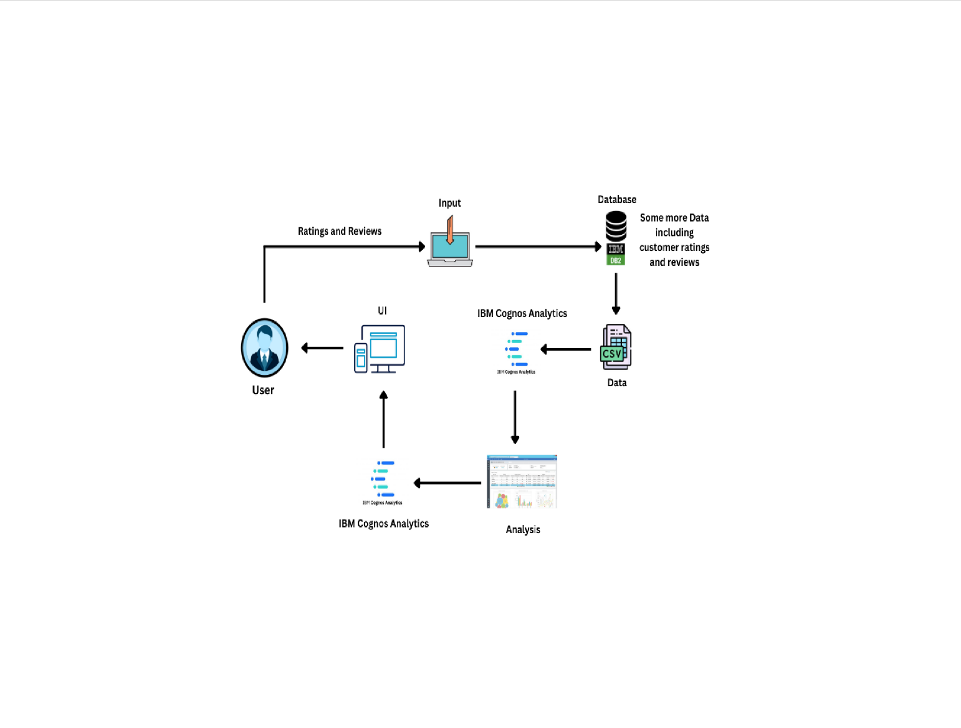
Solution architecture

Slide 7
TOOLS USED
HARDWARE REQUIREMENS
Processor : Intel Core i3
RAM : 8 GB
Hard Disk : 500 GB
SOFTWARE REQUIREMENTS
Operating System : Windows
Language : HTML, CSS, JavaScript, Python
Program – Tool : Visual Studio Code
Web Framework : Flask
TOOL REQUIREMENTS
Operating System : Windows 10
Disk Space : 256 MB
Processor : Intel atom processor
Version : 3.6.2

Slide 8
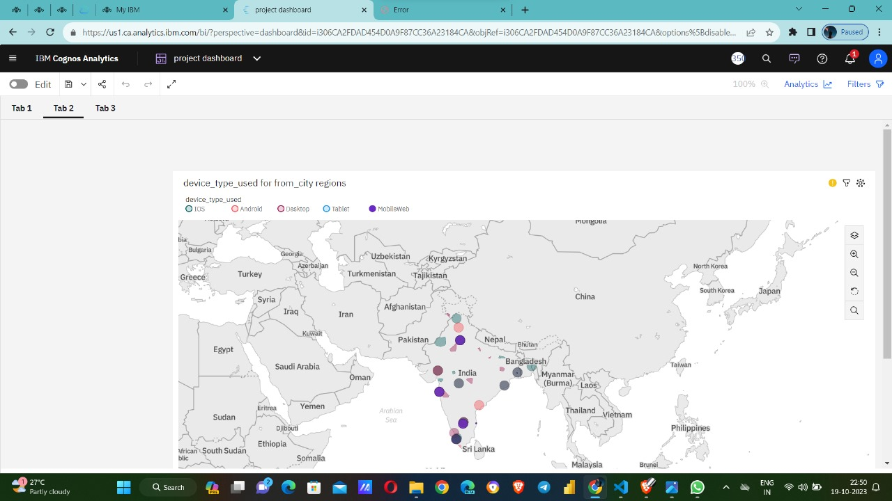
Dashboard

Slide 9
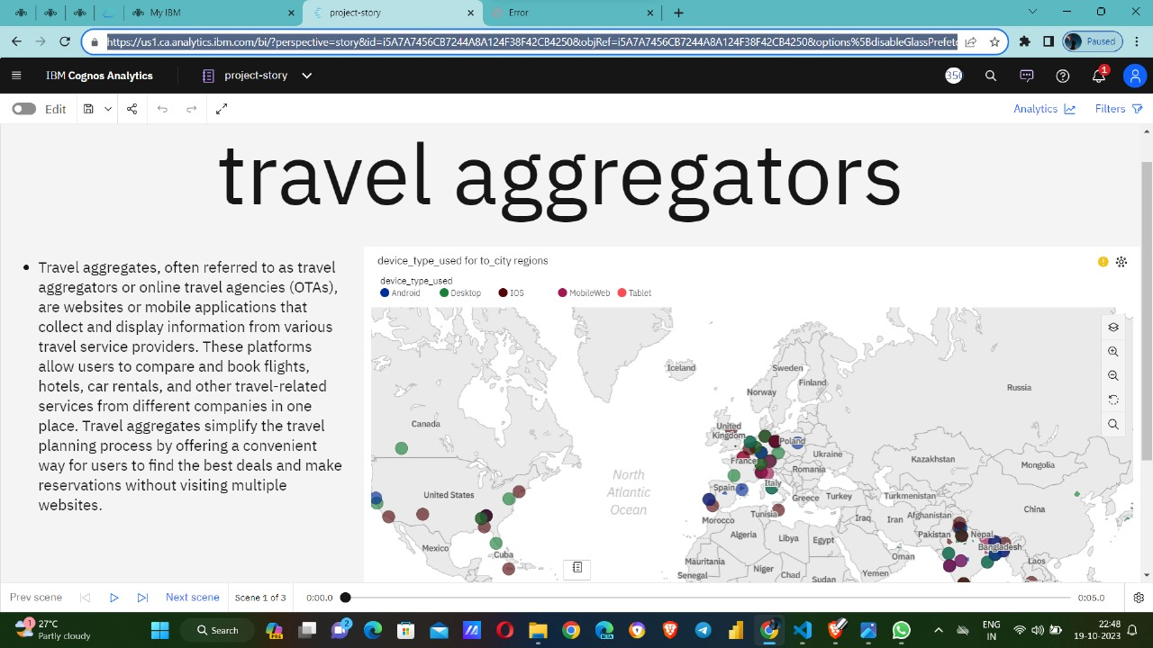
Story

Slide 10
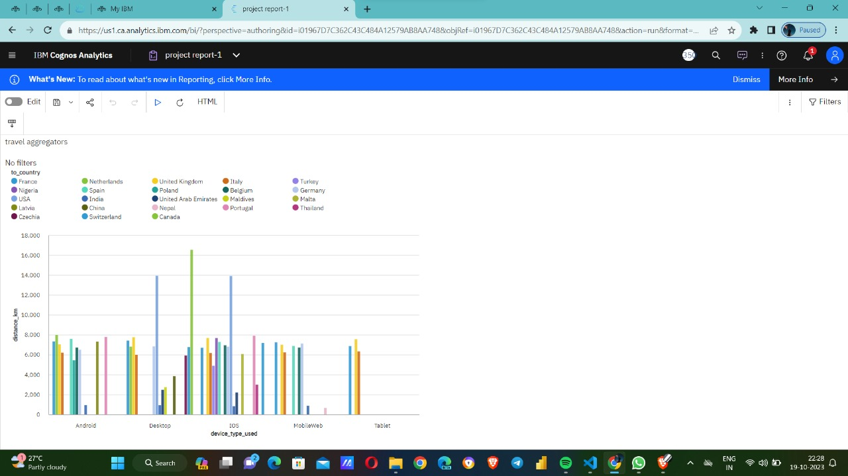
REPORT

Slide 11
THANK YOU

